Slide 1
COFFEE HOUSE
Frontend Project Presentation
Submitted to:
Submitted by:
Department of Computer Application
Pabitra (2510987068)
Shubham (2510987039)
Kushant (2510987066)

Slide 2
Problem:-
While creating the Coffee shop website using only HTML, CSS, JavaScript we face challenges in website layout and maintaining a consistent design across all pages.
Login and Signup Data Store
Providing a seamless user experience.

Slide 3
Features:-
Home Page
Login and Signup
Menu Page
Search Menu
About Page
Contact Page

Slide 4
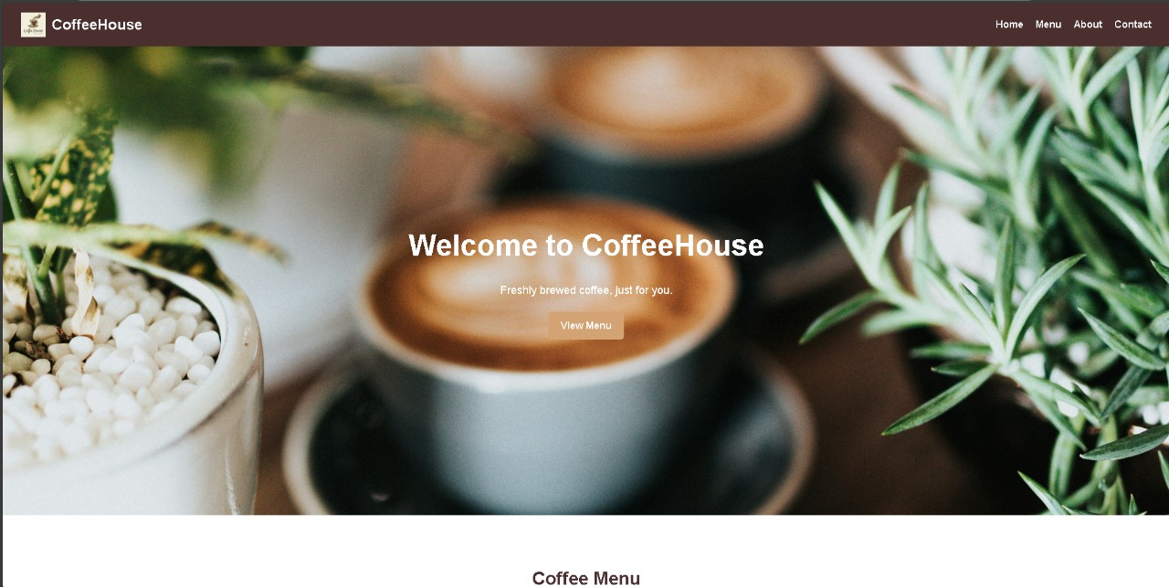

Slide 5
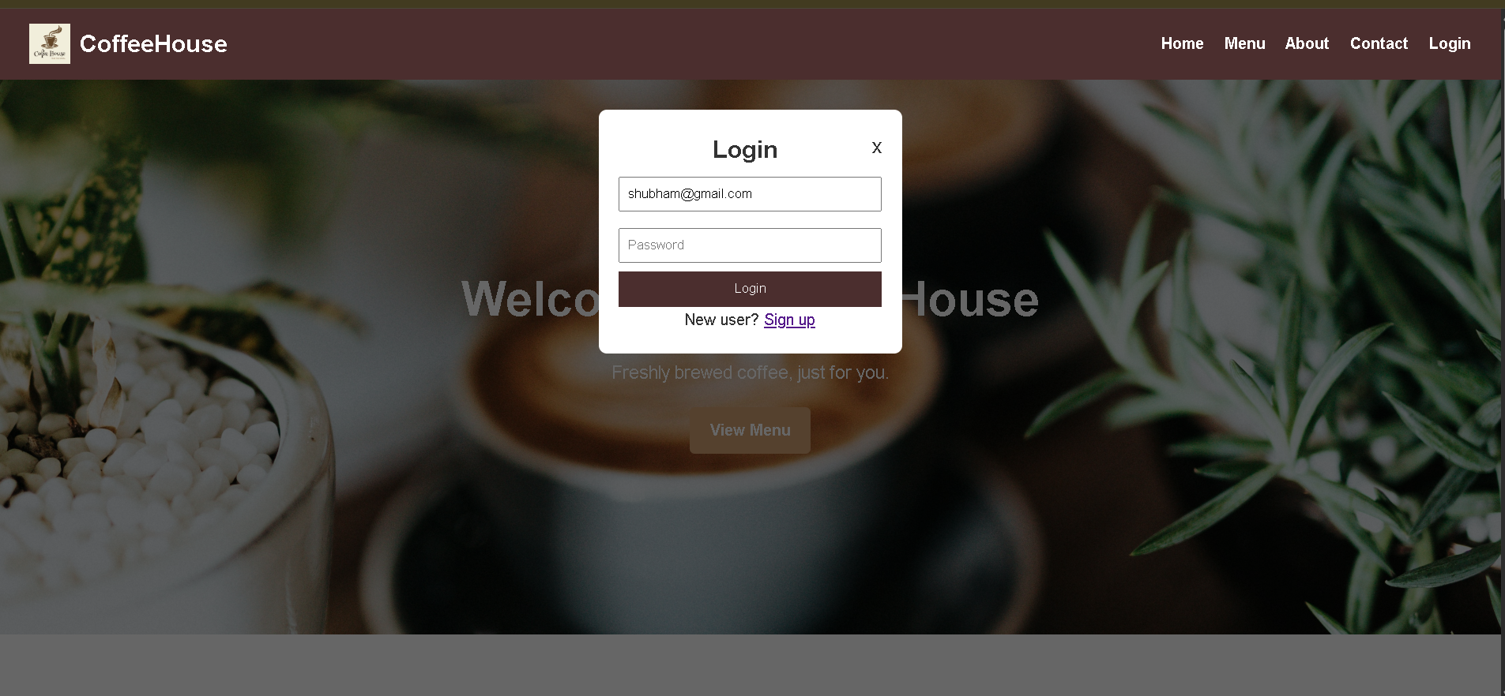

Slide 6
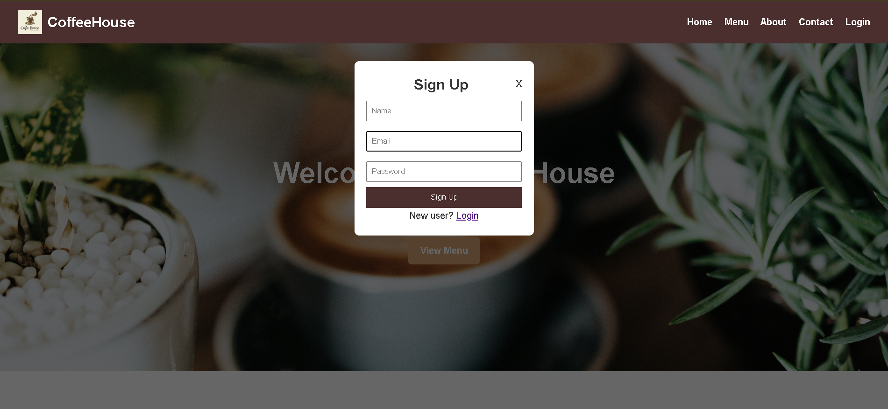

Slide 7
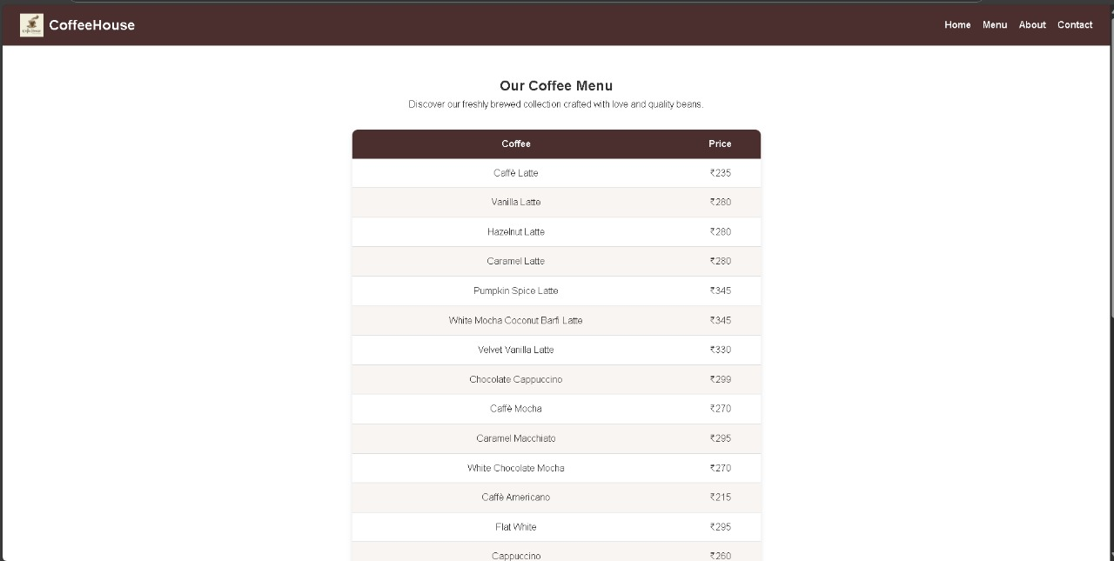

Slide 8
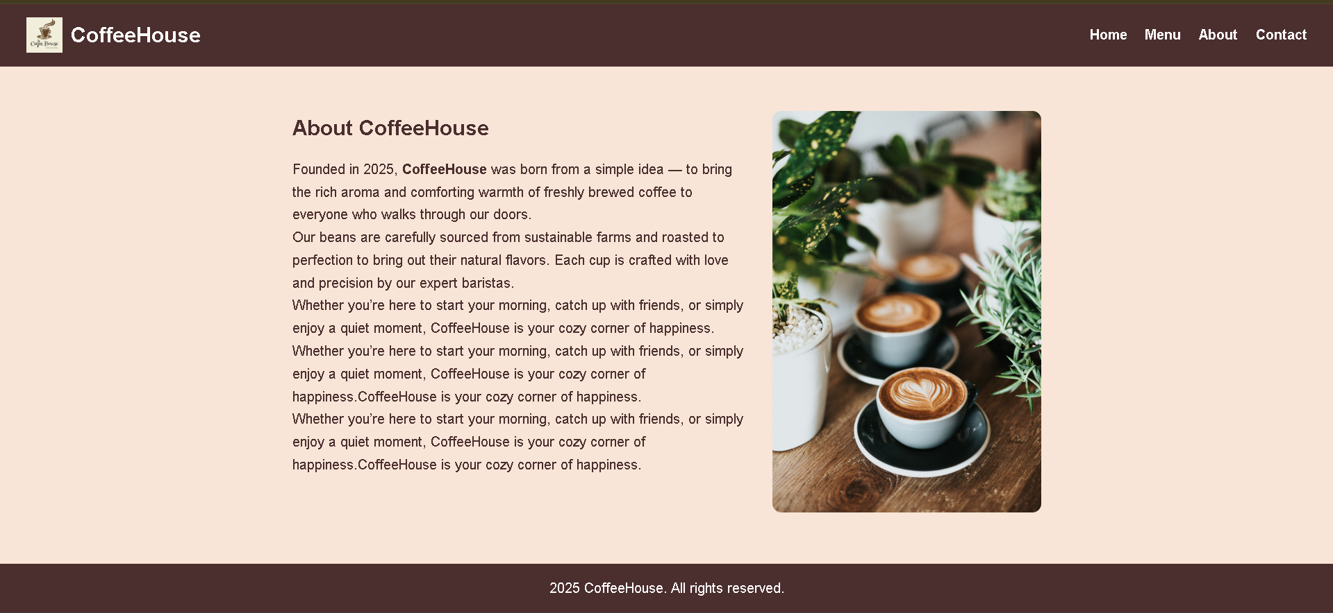

Slide 9
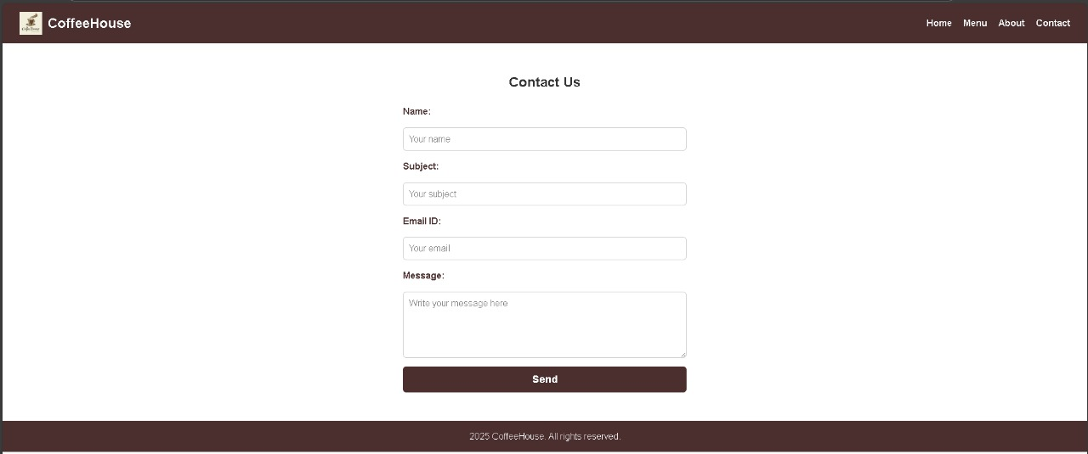

Slide 10
Conclusion:-
This project entitled Coffee House was completed successfully. The System has been developed with much care and free of errors and at the same time it is efficient and less time consuming. The purpose of this project was to develop an application for purchasing coffee from a café.

Slide 11
Thank You

